Slide 1
Internet Tools and Technology

Slide 2

alert method
prompt method
Java script event
.

Slide 3
Window alert() Method
To displays an alert box with a specified message and an OK button.
Used if you want to make sure information comes through to the user.
.

Slide 4
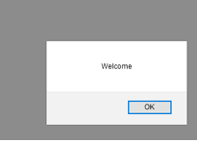
Window alert() Method
<html>
<head>
<script>
function disp()
{
alert("Welcome");
}
</script>
</head>
<body>
<H1>Alert Demo</H1>
<script>
disp();
</script>
</body>
</html>
.

Slide 5
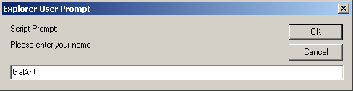
Window prompt() Method
When the user clicks OK, the value typed by the user is returned to the program as a string.
This is the prompt to the user.
This is the text field in which the user types the value.
This is the default value that appears when the dialog opens.
.

Slide 6
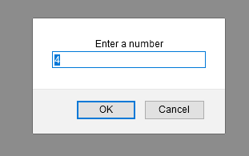
<html>
<body>
<p>sum of first n natural number</p>
<p id="demo"></p>
<script>
function myFunction() {
var n = prompt("Enter a number", "4");
if (n != null)
{
n++;
document.getElementById("demo").innerHML = "next number is " + n;
}
}
myFunction();
</script>
</body>
</html>
.

Slide 7
Java script Events
.

Slide 8
The change in the state of an object is known as an Event.
Events are the actions that can be detected by the javascript.
web page has finished loading
button was clicked
input field was changed
.

Slide 9
This process of reacting over the events is called Event Handling.
Javascript handles events via Event Handlers.
Event handlers are embedded in documents as attributes of HTML tags to which you assign JavaScript code to execute.
<TAG eventHandler="JavaScript Code">
Window/Document events
Form events
Mouse events
Keyboard events
.

Slide 10
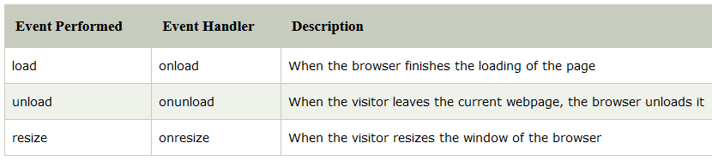
Window/Document events
.

Slide 11
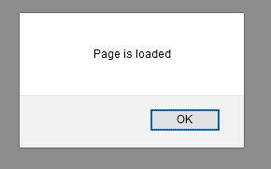
Window/Document events
<html>
<body onload="myFunction()">
<h1>Hello World!</h1>
<script>
function myFunction() {
alert("Page is loaded");
}
</script>
</body>
</html>
<img src=“ict.jpg" onload="loadImage()" width="100" height="132">
.

Slide 12
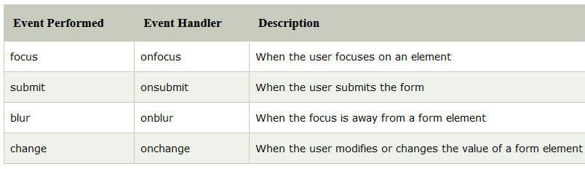
Form events:
.

Slide 13
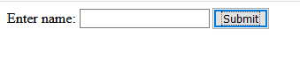
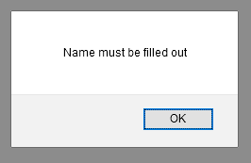
Form events:
<html>
<body>
<form name="form1" action="/registration.py" onsubmit="return myFunction()">
Enter name: <input type="text" name="fname">
<input type="submit" value="Submit">
</form>
<script>
function myFunction() {
var x = document.forms["form1"]["fname"].value;
if (x == "") {
alert("Name must be filled out");
return false;
}
}
</script>
</body>
</html>
.

Slide 14
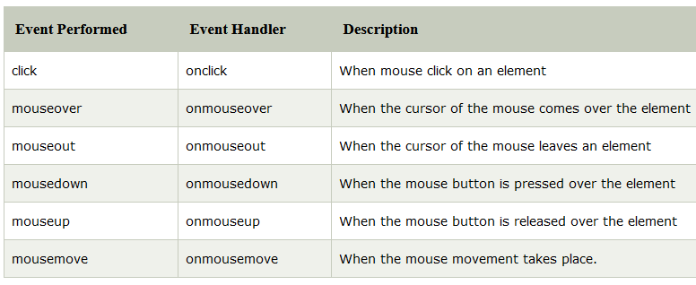
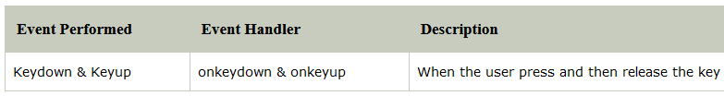
Mouse events:
Keyboard events
.

Slide 15
Mouse events:
<html>
<body>
<button onclick="myFunction()">Click me</button>
<p id="demo">MIT Manipal</p>
<script>
function myFunction() {
document.getElementById("demo").innerHTML = "ICT Department";
}
</script>
</body>
</html>
.

Slide 16
Mouse events:
<html>
<head>
<script>
function myFunction()
{
document.getElementById("p1").style.color = "red";
}
function myFunction2()
{
document.getElementById("p1").style.color = "blue";
}
</script>
</head>
<body>
<p id="p1" onmouseover="myFunction()" onmouseout="myFunction2()"> welcome to ICT </p>
</body>
</html>
.

Slide 17
.

